Slide 1
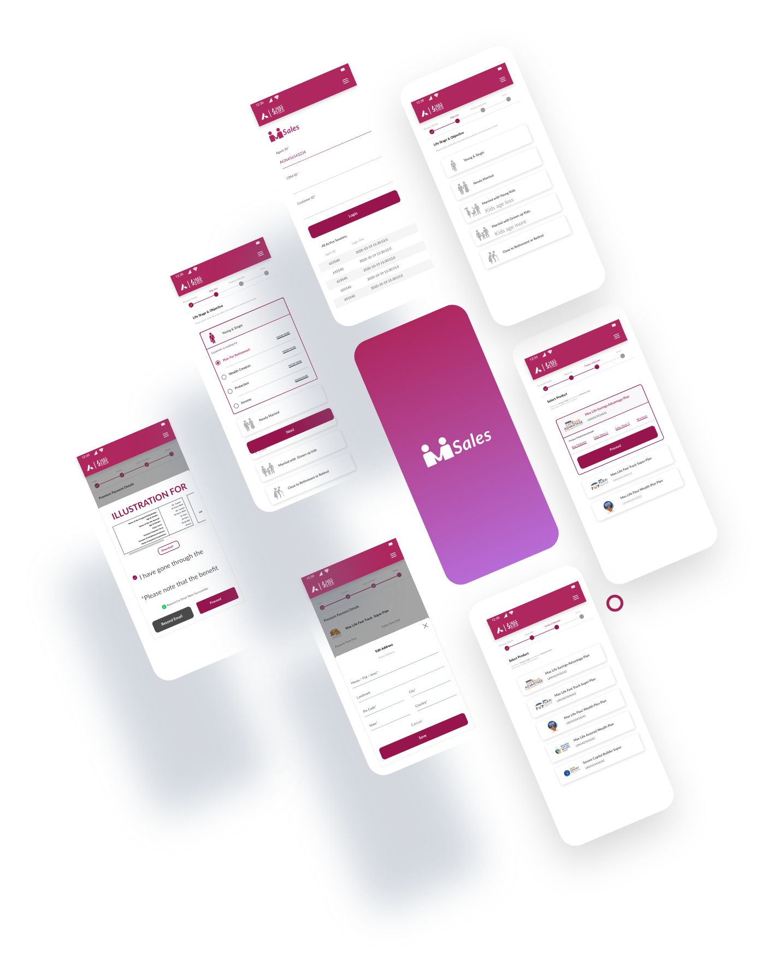


Msales | Axis bank
UX Case Study

Slide 2
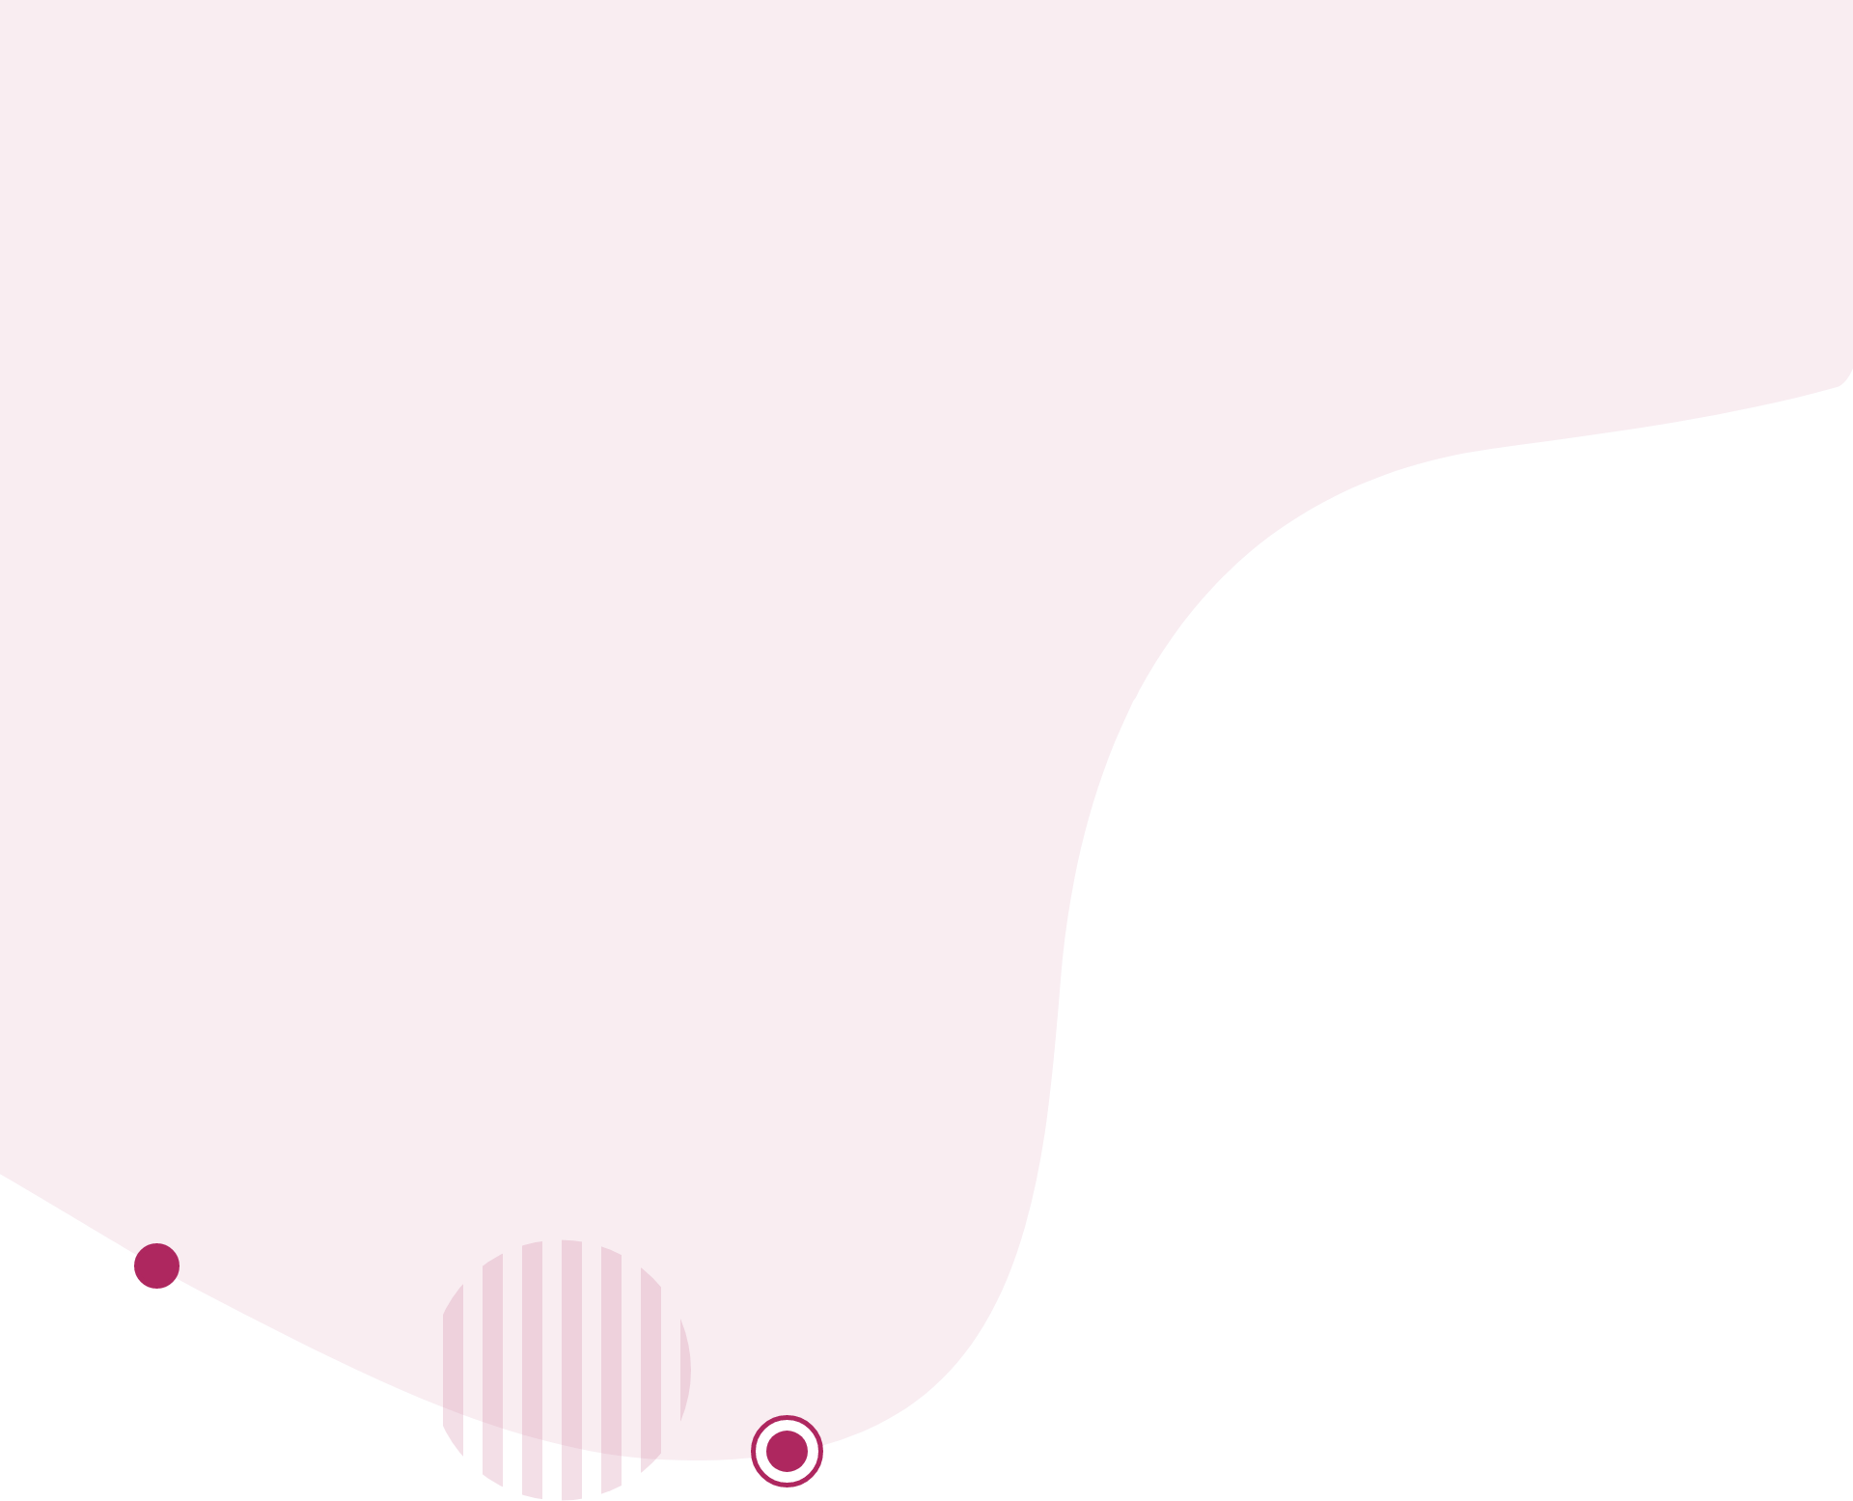
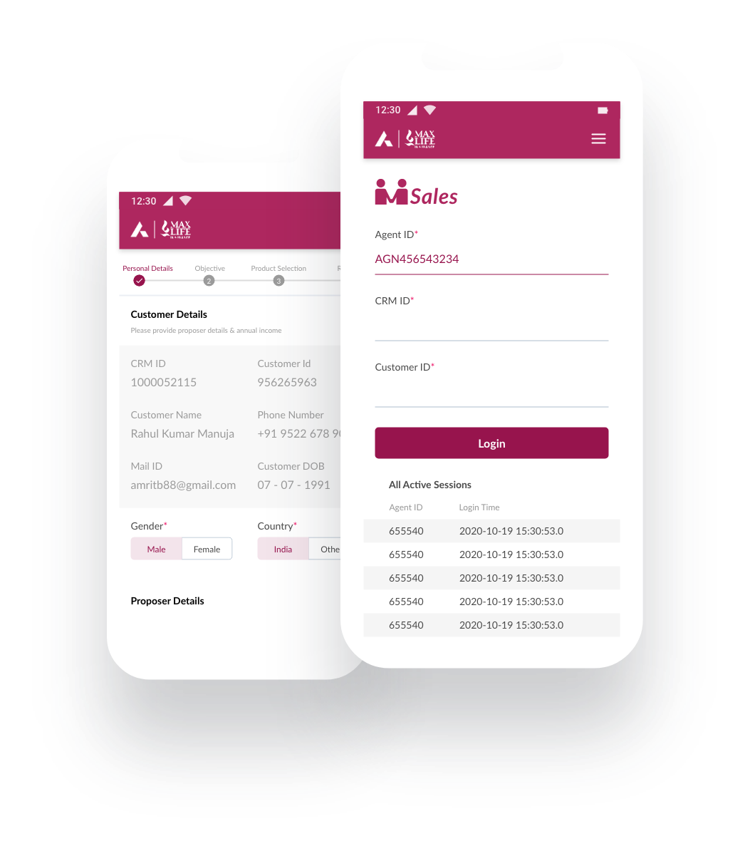
About
SP and POSP (users) are bank people who pitch and sale Max Life insurance products to bank customers. Once a bank customer shows its interest, SP / POSP update personal information, customer profile (annual income, life/saving goals etc) in mSales to parse the lead to Max Life system.
Problem Statement
mSales being used by Axis bank requires an easy process to capture lead information. Product team have recently upgraded to a responsive user interface (as asked by bank) which is slightly better as compared to the old webapp (which was only adapted to laptop/desktop screens).
Task is to understand the process being followed by users (SP & POSP) and prepare a solution that can increase their productivity.

Slide 3
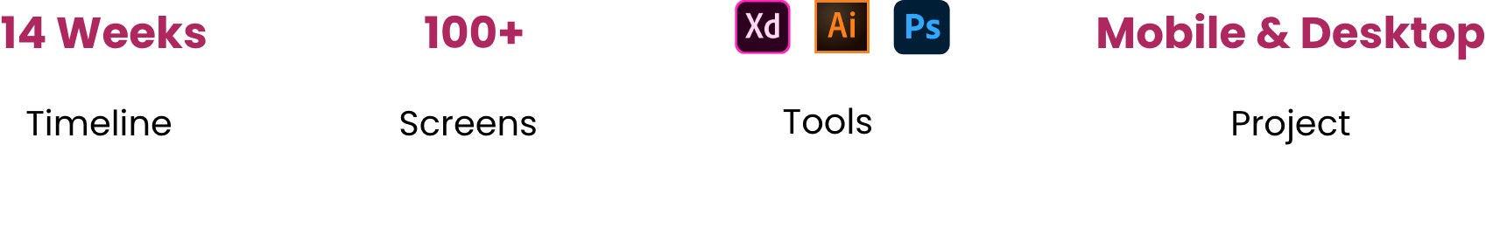

Solution
Our proposed solution aims to enhance the user experience by segmenting input data into manageable steps. Each section will be clearly titled for easy navigation, and we will automate the retrieval of customer details from Axis Bank’s existing records, since we are targeting Axis Bank customers with our policy pitches.
Project overview
Design Process

Slide 4
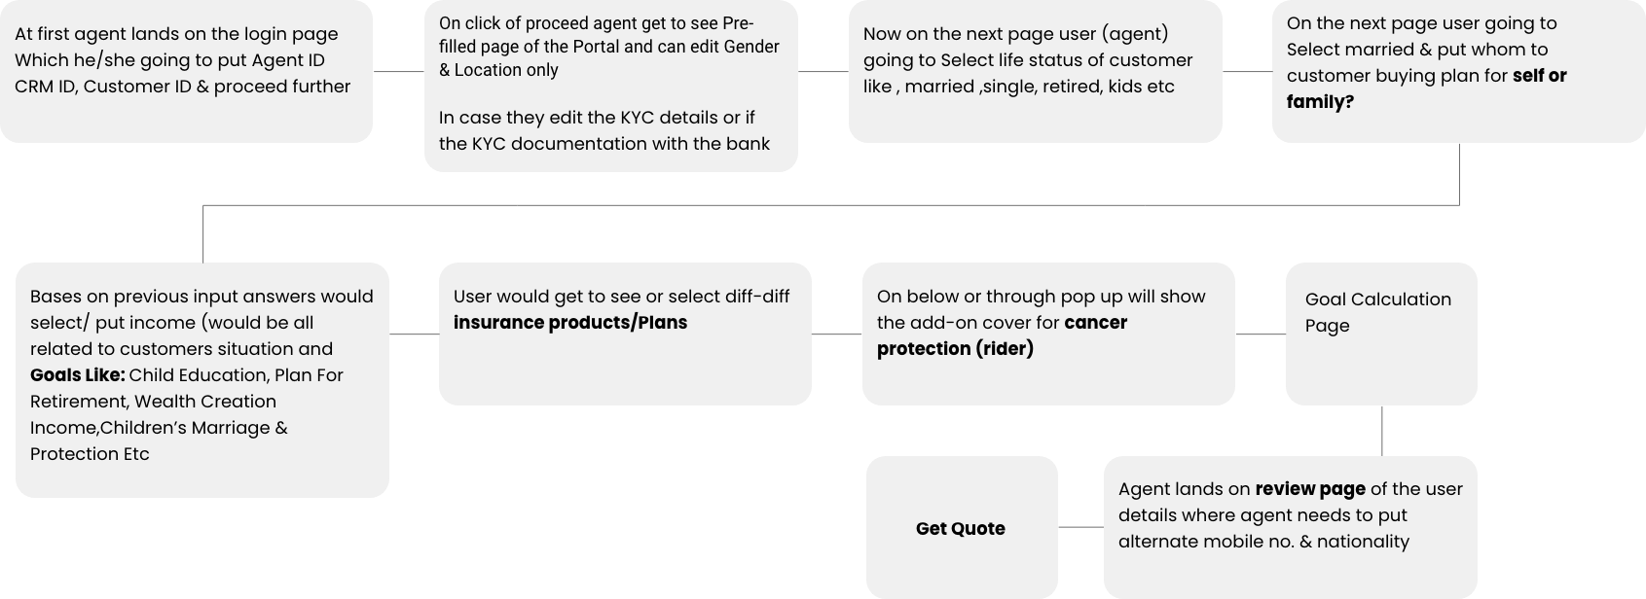
User Flow

Slide 5
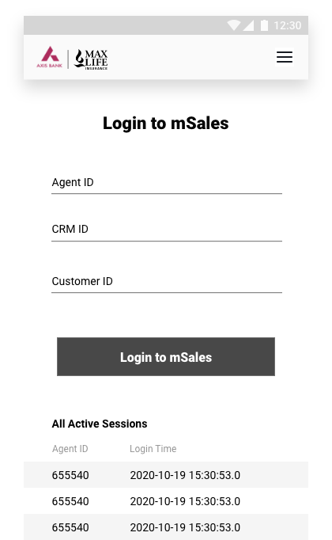
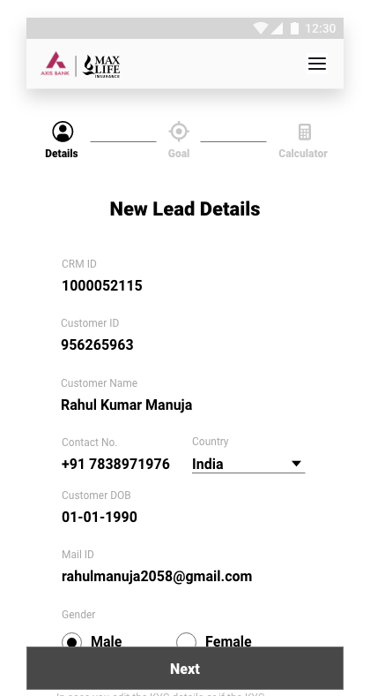
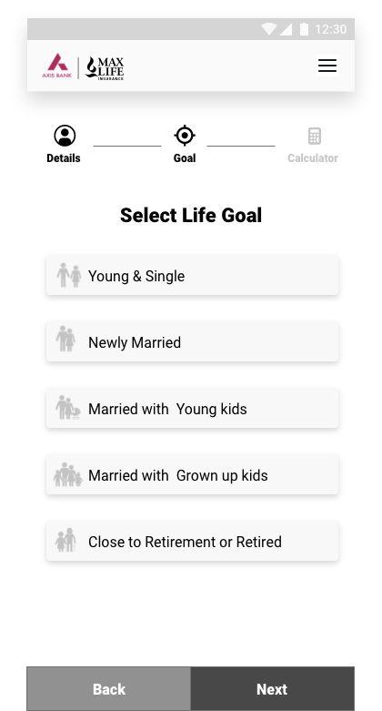
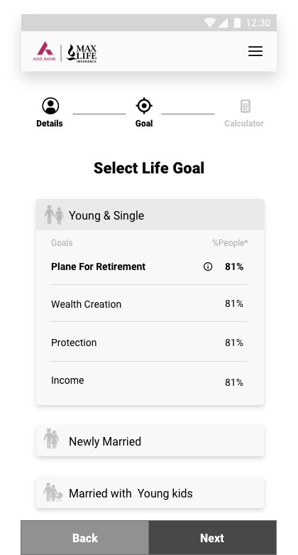
Low Fidelity Wireframes

Slide 6
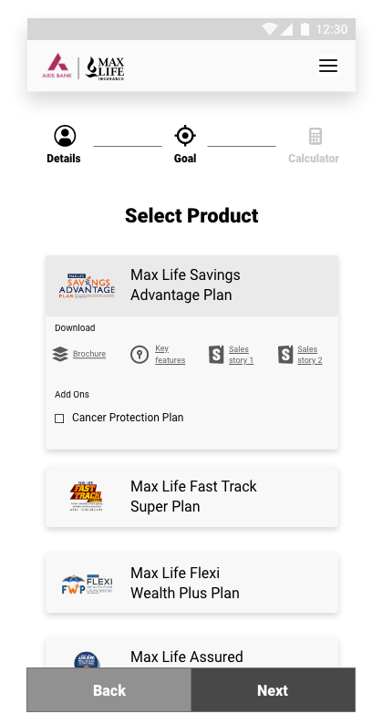
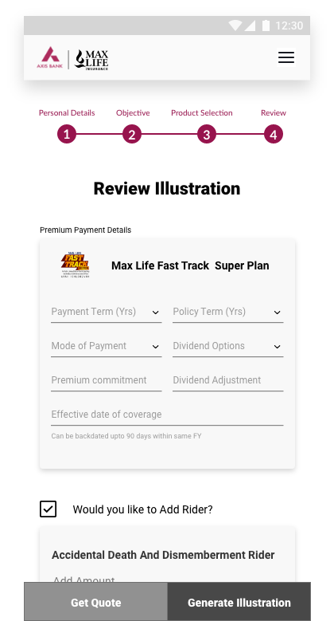
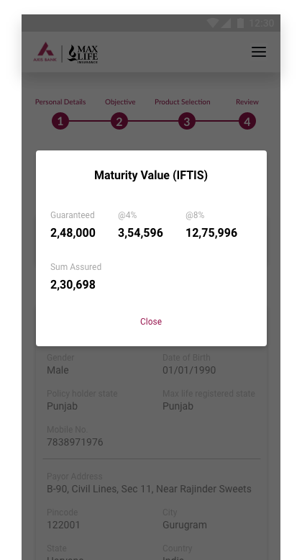
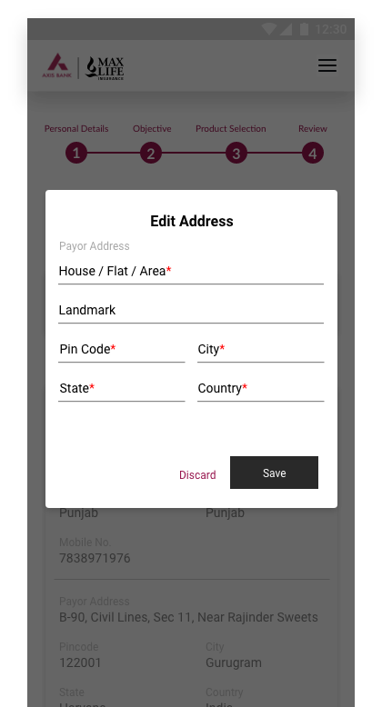
Low Fidelity Wireframes

Slide 7
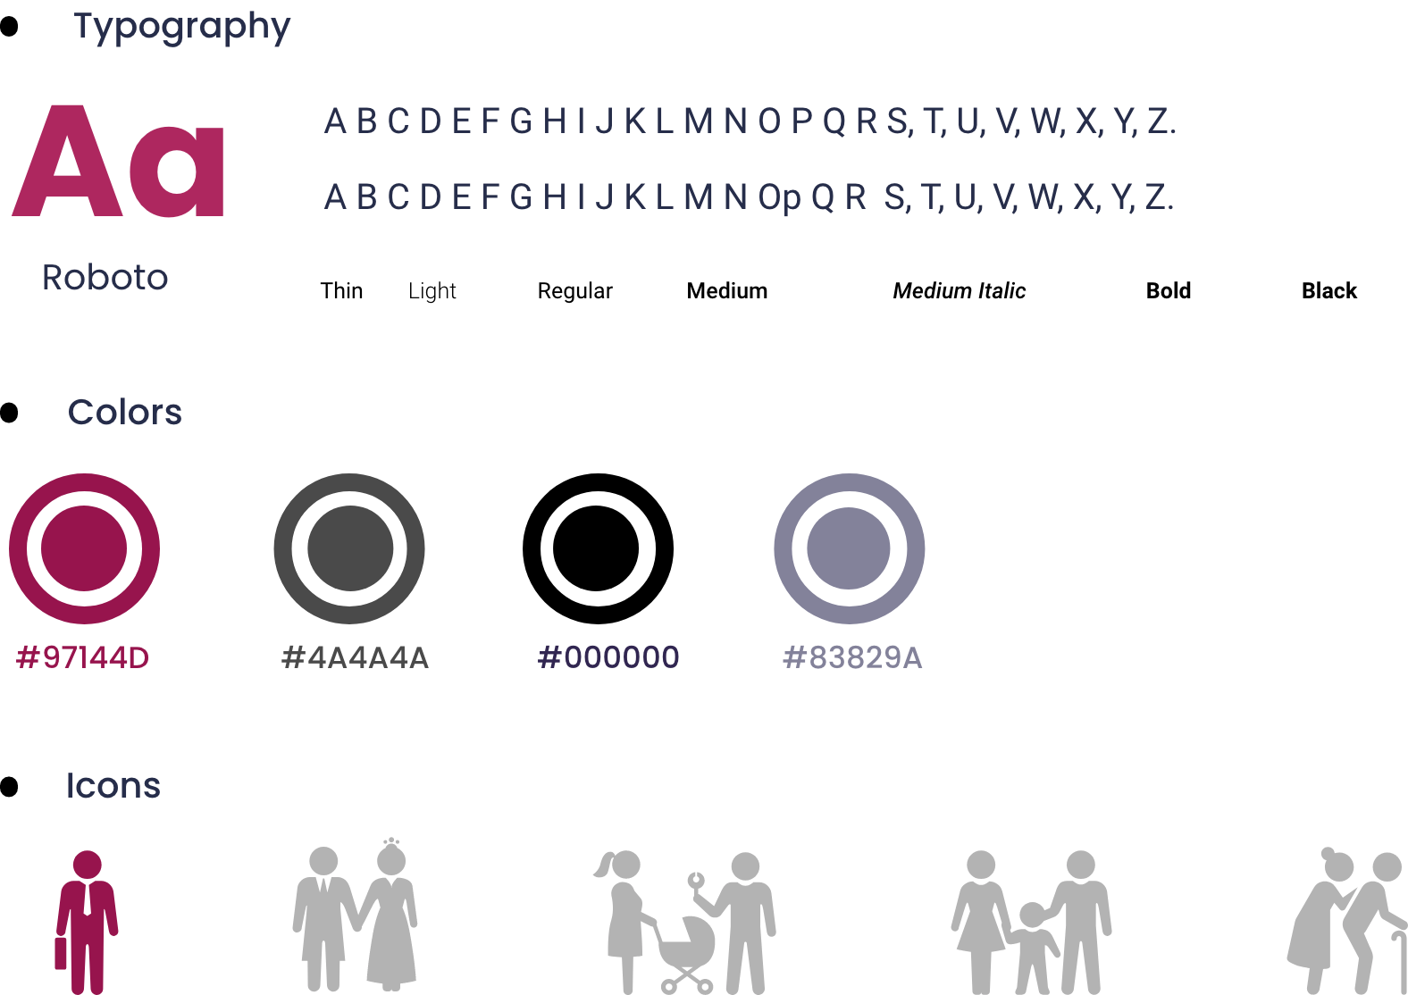
Design System

Slide 8
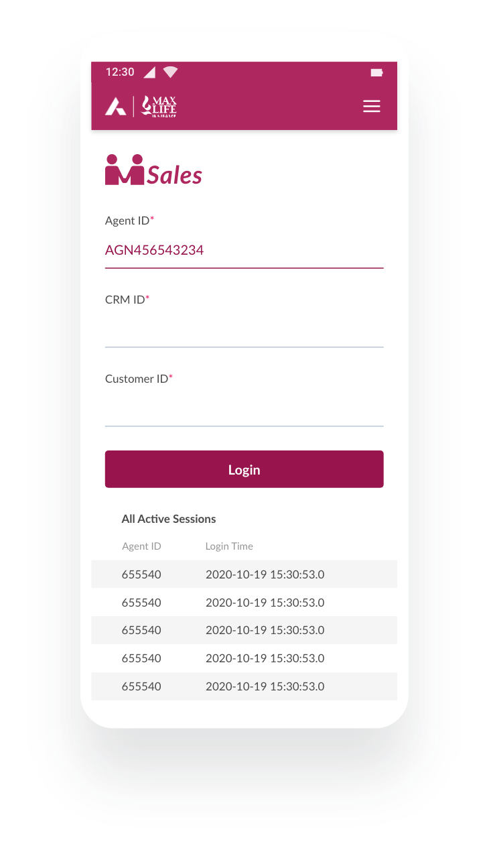
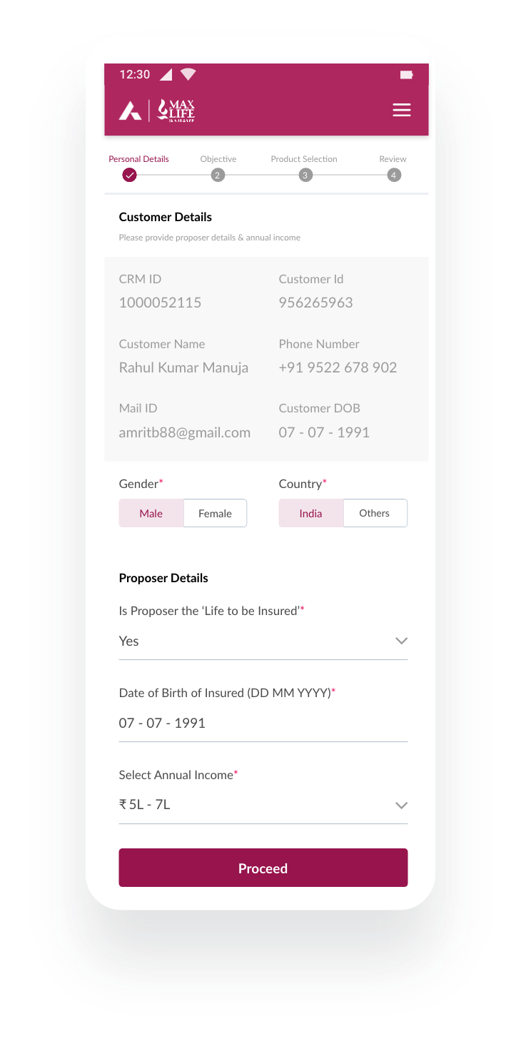
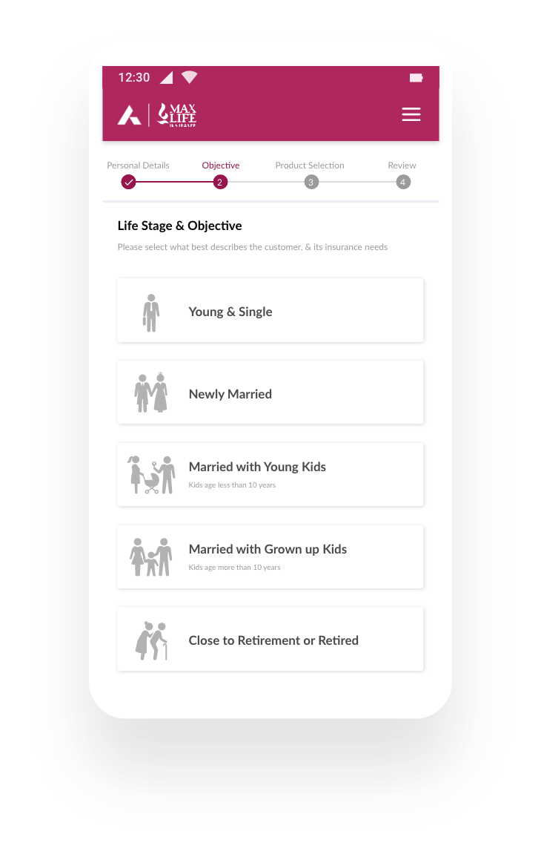
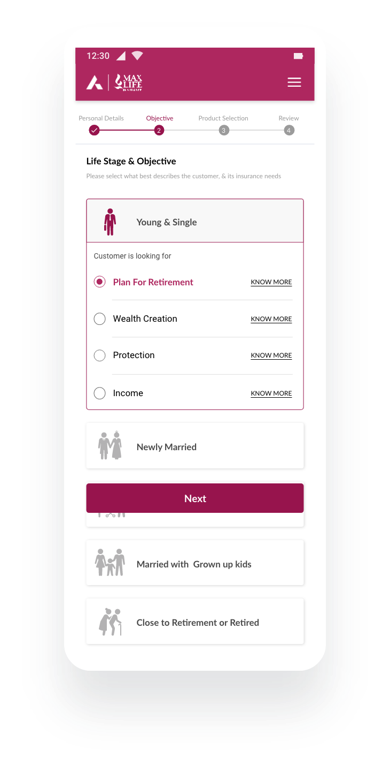
Designs

Slide 9
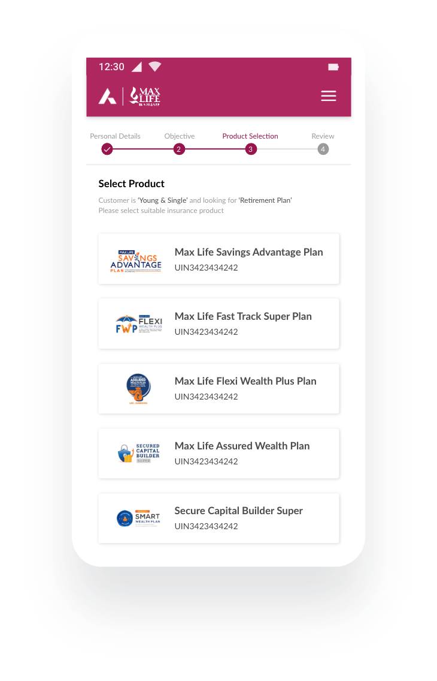
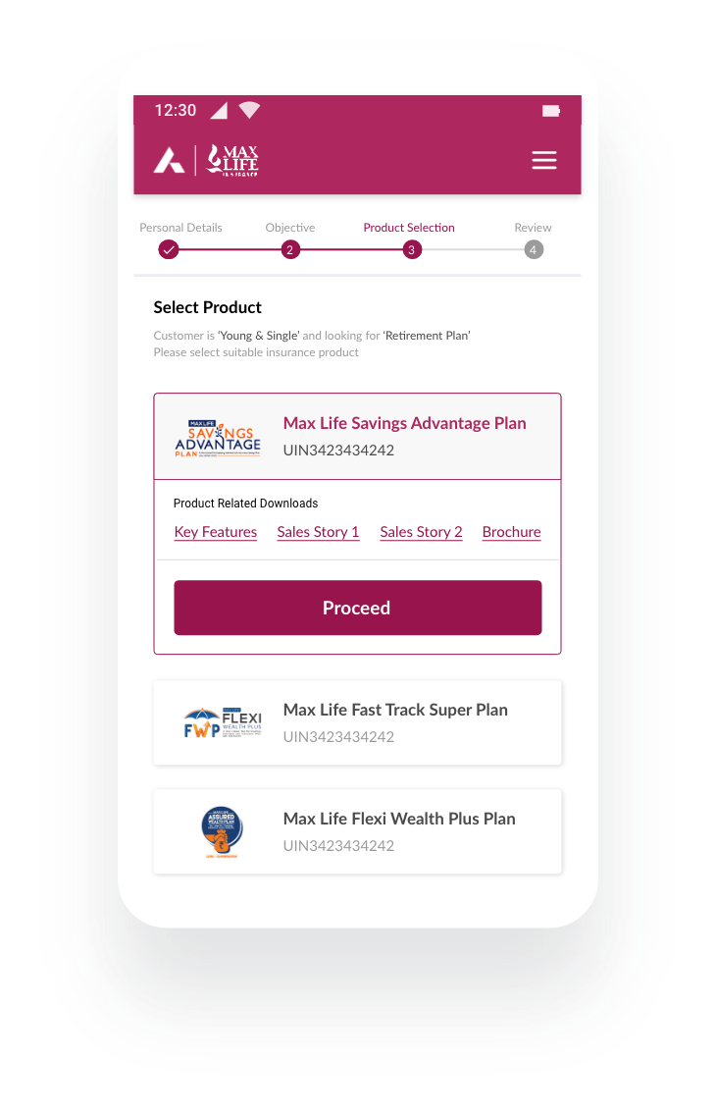
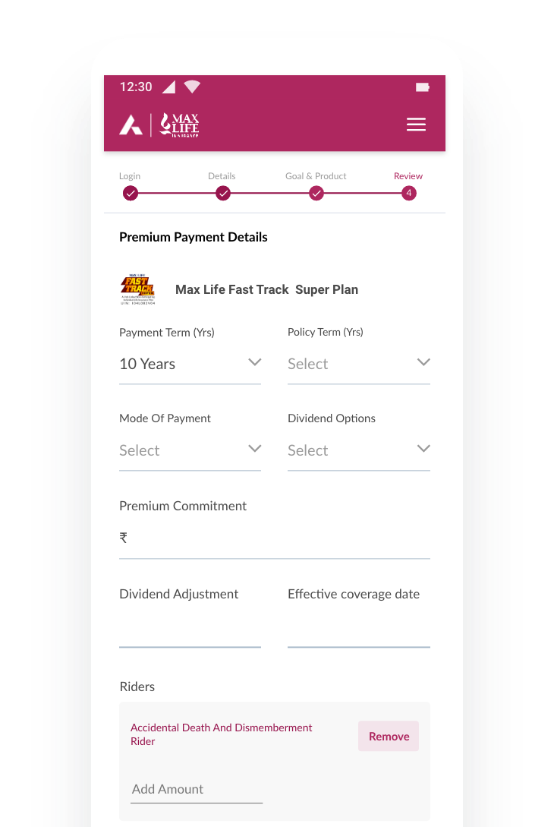
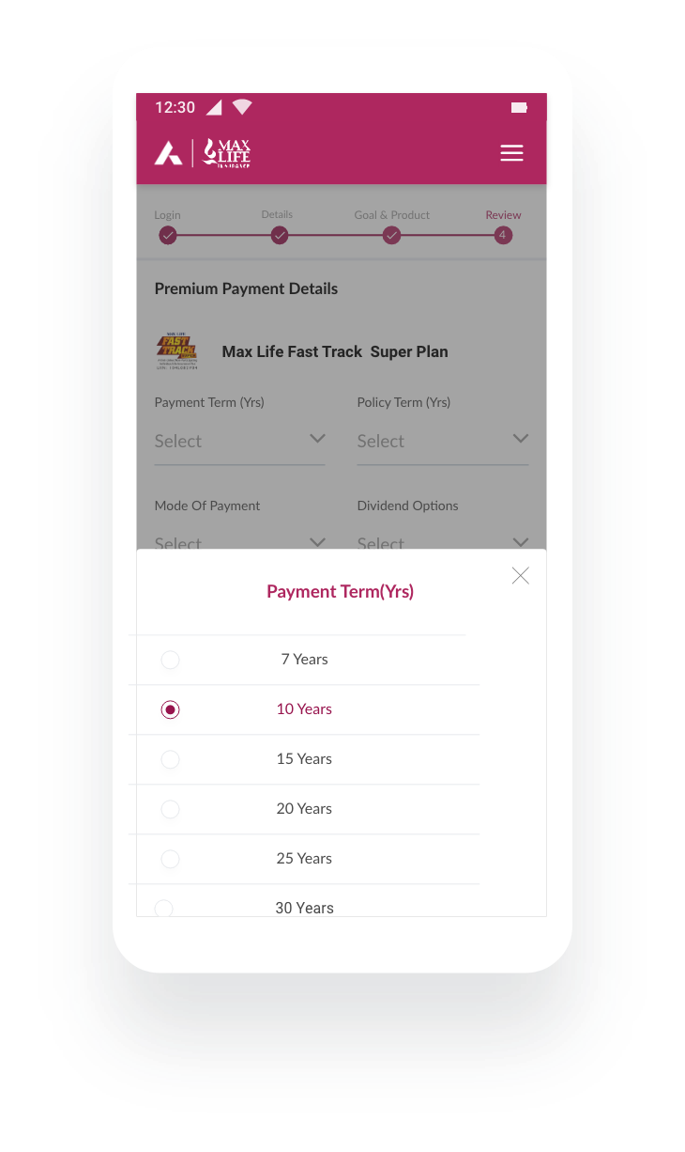
Designs

Slide 10
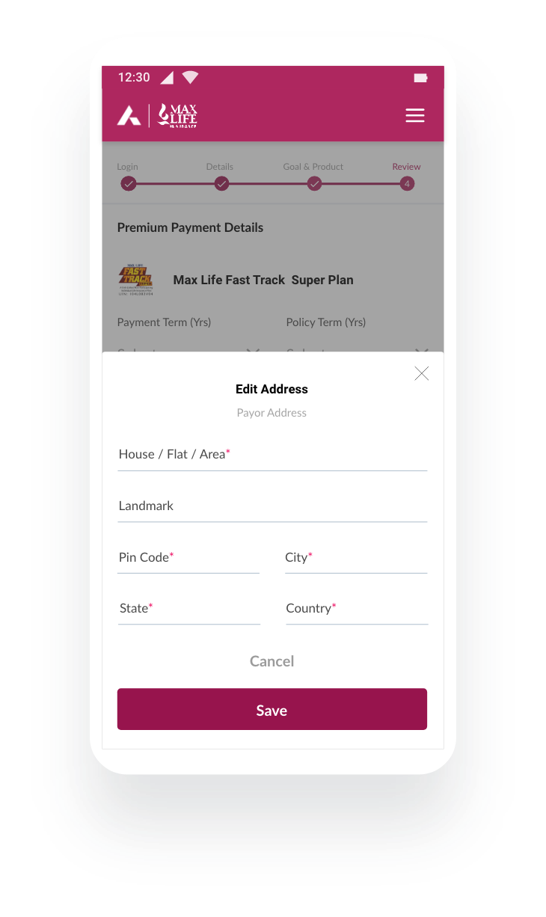
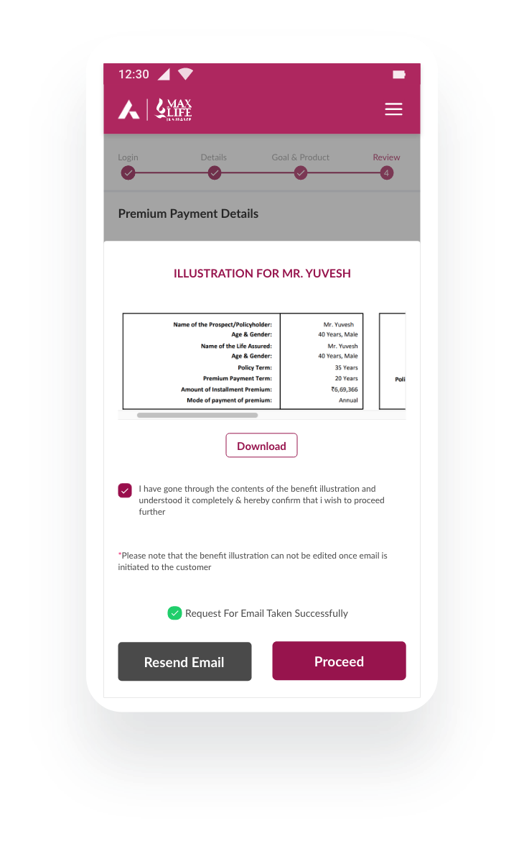
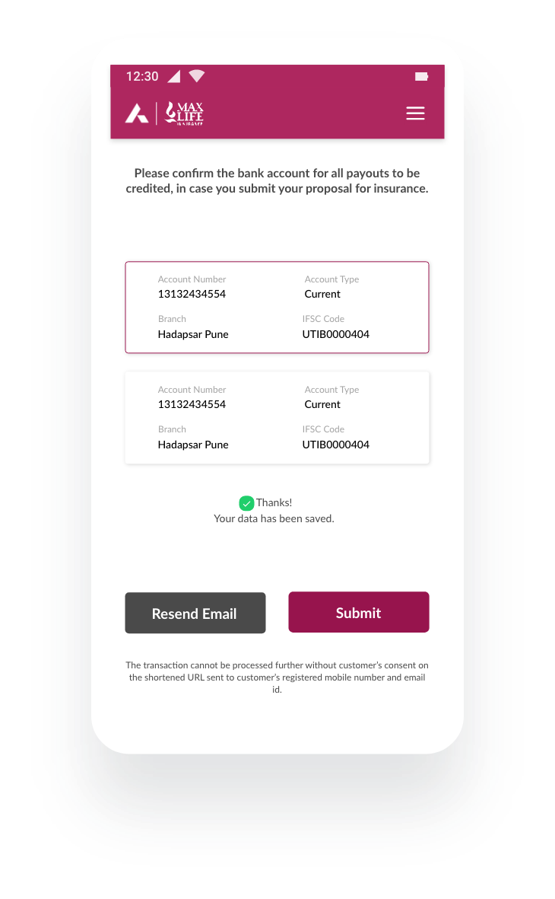
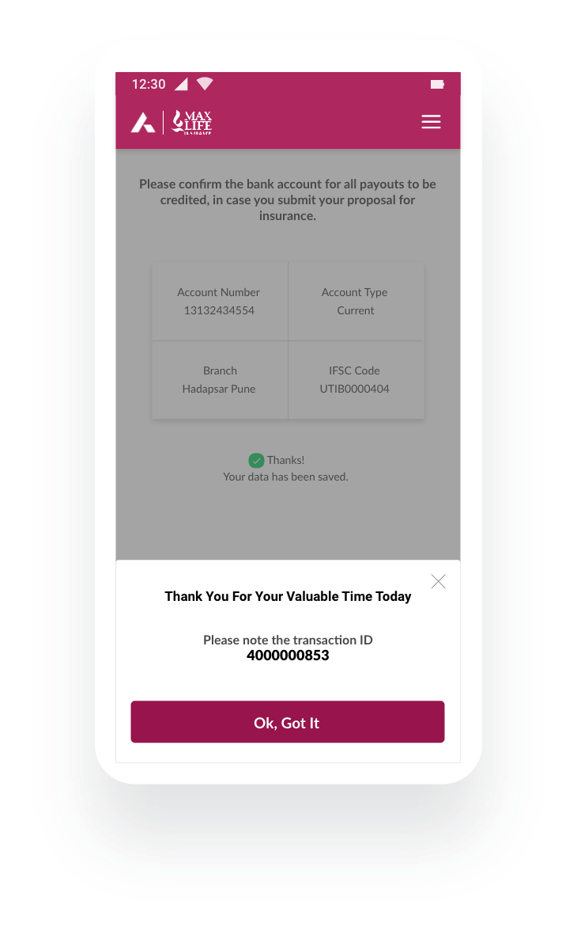
Designs

Slide 11
To view entire flow/screens of final design pls visit below link
Thanks

